Slide 1

Pass the Plate:
A Serving of Thanksgiving
Semaphores

Slide 2

The Guests
In our program, the processes which need to access the shared memory segments are the guests.

Slide 3
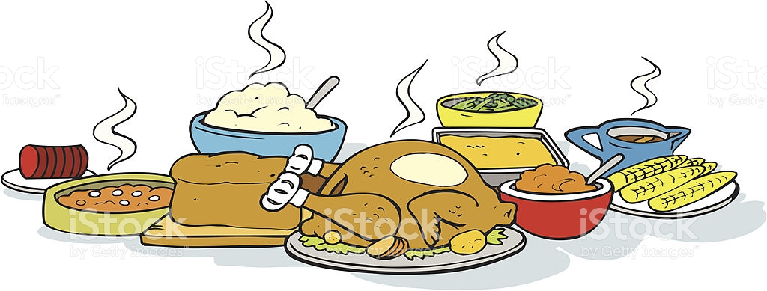
The Dishes
The shared memory segments are represented by dishes. There is only one dish for each “guest” to share, so each guest needs to use the dish and then can pass it to their neighbors.

Slide 4

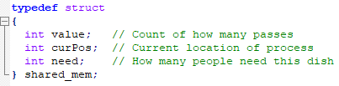
The Dishes (Ingredients)
Since the dishes are representing our shared memory segments we need to create a struct that will define the values that will be modified. These include the number of times the dish has been passed, the current position at the table, and how many people need the dish.

Slide 5
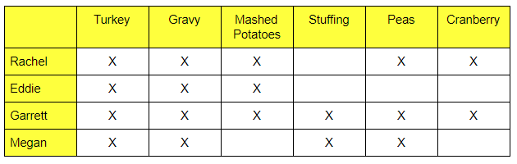
How Many People Need the Dish?

Slide 6

Seats at the Table
The guests are sat at the table and the child processes are forked based on their seat positions. This also determines who each person can pass and receive food from.
3
2
1
0
Notes:
Rachel

Slide 7
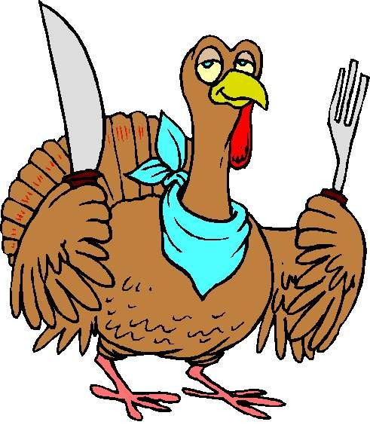
Serving
While somebody is serving themselves from a dish it is protected with a POP function to protect the critical section while the values for the number of passes, the number of remaining people who need the dish, and the current position update. Once complete a VOP function releases the semaphore.
Notes:
Rachel

Slide 8
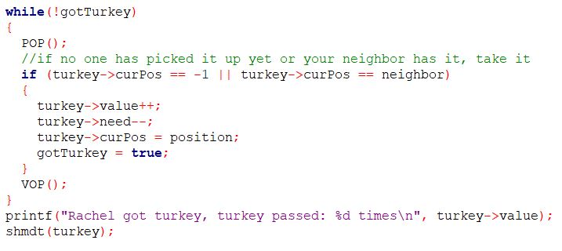
Notes:
Rachel

Slide 9
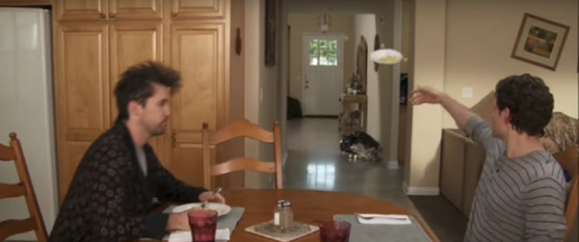
Passing
If a plate hasn’t been served from yet a guest can pass it to themselves.
If a plate is held by a preceding neighbor it can be passed to the next guest.
If a plate reaches somebody who doesn’t need it they will pass it without modifying the remaining number of people who needs that plate.
Notes:
Rachel

Slide 10
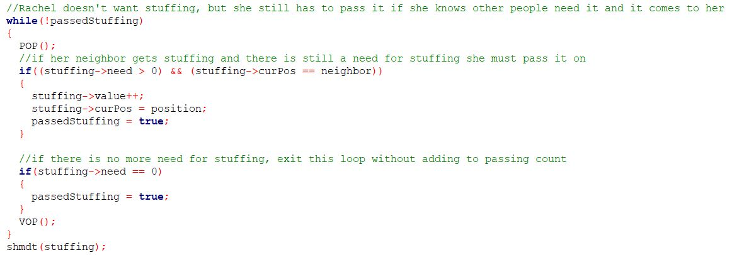
Notes:
Rachel

Slide 11
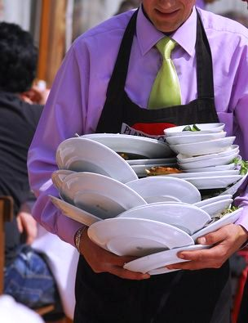
Clearing the Table
At the end of the program it:
Waits for all child processes to end, printing PID when done
Prints the number of times each dish was passed
Detaches from shared memory
Deallocates shared memory and semaphores

Slide 12
DEMONSTRATION
Notes:
Rachel

Slide 13
After Dinner Conversation
Much like the the Dining Philosophers even though this isn’t a real world problem it uses concepts that can be applied to real world problems involving concurrency.
By implementing rules regarding how the plates are passed around the table we prevent both deadlock and starvation, making sure that unwanted plates do not pile up at a process and that each process is able to get the food they want.
The goal is to show that given concurrency rules a program can be optimized by arranging the order in which the processes access the shared memory segments.

Slide 14
QUESTIONS?

